Slide 1

Real-time Analytics on Delta Lake
24th June 2020
Mohd Hasnain

Slide 2
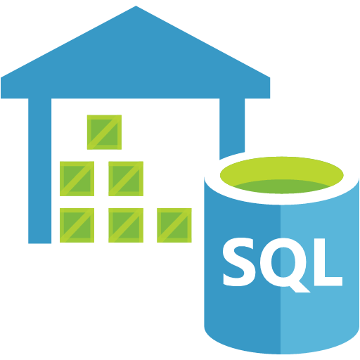


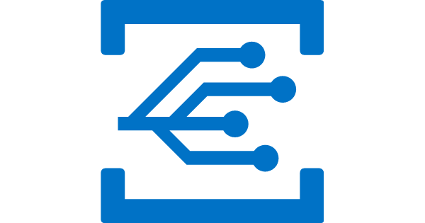



Agenda
Modern Data Warehouse
Lambda Architecture
Delta Architecture
Apache Kafka
Azure Event Grid
Azure IoT Hub
Azure Event Hub
Azure Stream Analytics
λ

Slide 3
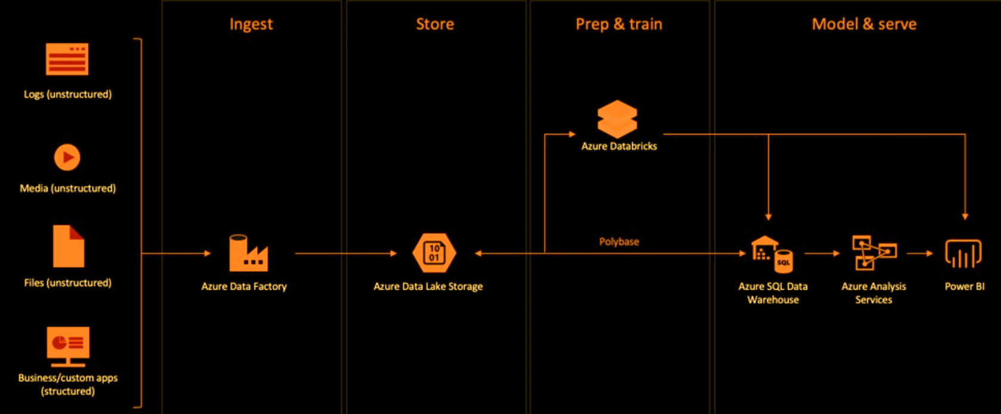
Modern Data Warehouse

Slide 4
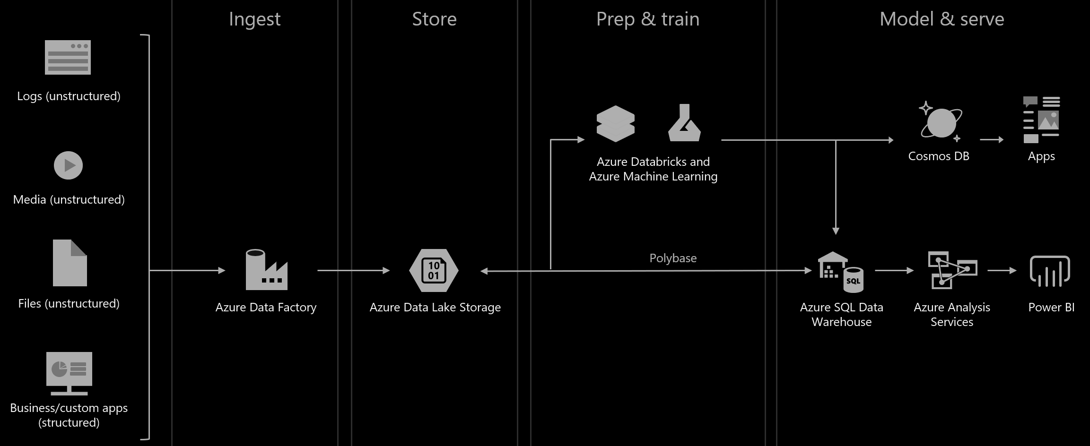
Modern Data Warehouse + Advanced Analytics

Slide 5
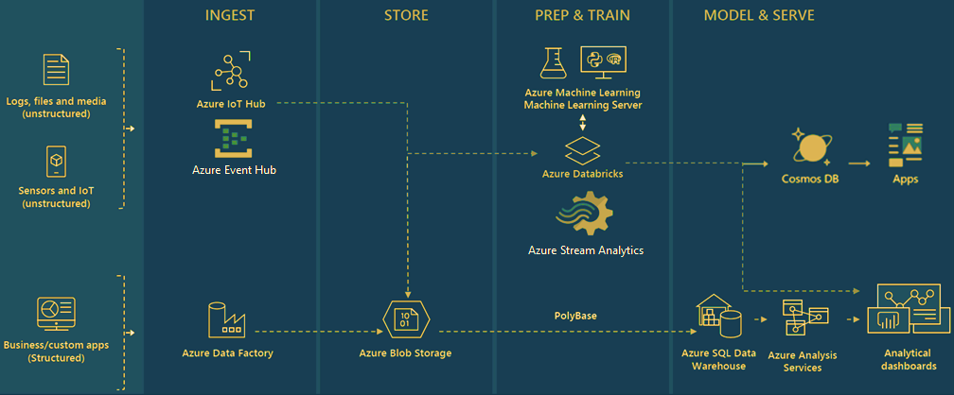
++ Real-time Analytics

Slide 6
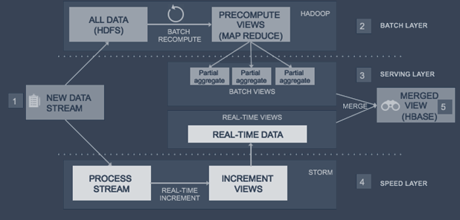
Beyond λ-Arch
λ
Lambda Architecture
Records are processed by a batch and streaming system in parallel
Results are then combined during query time to provide a complete answer
Strict latency requirements to process old and recently generated events
Challenge
Development and operational overhead of managing two different systems
Delta Architecture
What if Batch and streaming into a single system
Simple continuous data flow model to process data as it arrives
Power of Delta to reduce complexity
Notes:
Challenge with lambda
Complexity
Validation
Reprocessing
Manual Compaction
Development and operational overhead of managing two different systems

Slide 7
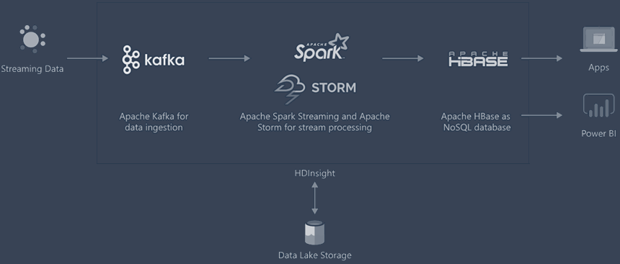

Streaming using HDInsight (Apache Kafka)

Slide 8
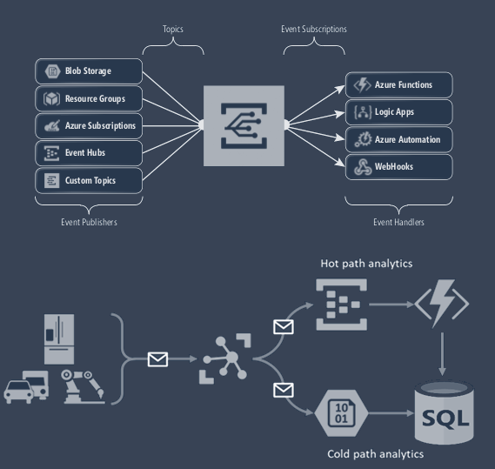
Azure Event Grid
Event routing service – react to event
Publisher-Subscriber model
Not registered in DA subscription
Example:
Filters to route specific events to different endpoints
Multicast to multiple endpoints
COST: $0.60 per million operations
SLA: 99.99%
Azure IoT Hub
IoT-specific capabilities
Establish bidirectional communication
Authenticate every device for enhanced security
Automate device provisioning to accelerate IoT deployment
COST: $0.10 per 1,000 operations
SLA: 99.9%
Notes:
Event Grid Basic tier is priced as pay-per-use based on operations performed. Operations include ingress of events to Domains or Topics, advanced matches, delivery attempts, and management calls. Plan pricing includes a monthly free grant of 100,000 operations.

Slide 9
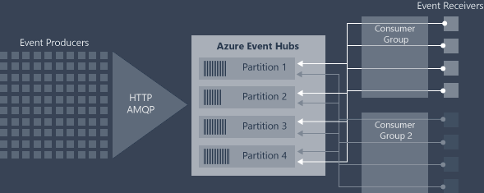
Azure Event Hub
A big data streaming platform and event ingestion service
Scalable, Reliable (No Data Loss), Support multiple protocols and SDKs
Key Concepts:
Event producers send events via AMQP, HTTP, Kafka
- separated in 1* to 32 partitions
(load balanced, ordered within partition only)
Event Hub – unique stream of data
Event Hub Namespace – Collection of Event Hub (Scoping Container with Shared properties)
Consumer Group – unique view on event hub data
- offset: position of event
- Checkpointing: save offset at client side
COST
Throughput - $0.03/hour
(1 MB/s ingress, 2 MB/s egress)
Ingress - $0.028 per million events
Capture - $0.10/hour
SLA: 99.95% (Standard)

Slide 10
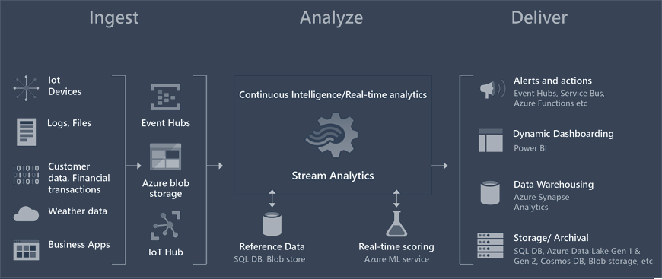
Azure Stream Analytics
Real-time analytics and complex event-processing engine
SQL over stream of data - Stream Analytics Query Language
Can join multiple stream, self join
Out of the box Azure Integrations
Built in ML based anomaly detection
Built-in and Custom function
Support complex types
COST
$0.11/hour per streaming unit + $1/device/month for IoT job
SLA: 99.9%

Slide 11
Which One To Use?
Event Hub vs Kafka
Apache Kafka (Open Source) is installed and run
Apache Kafka required custom code in Java or C# and depend on Zookeeper
Azure Event Hubs is a fully managed service i.e. No to manage servers or networks or worry about configuring brokers
While Kafka is popular with its wide eco system and its on-premises/cloud presence
Event Hub vs IoT Hub
Azure Event Hub - Device-to-cloud messaging only
IoT Hub - Device-to-cloud and Cloud-to-device messaging (bi-directional communication)
Azure Stream Analytics
Process, and analyze streaming data from Azure Event Hubs, IoT Hub etc.
Faster Learning Curve

Slide 12
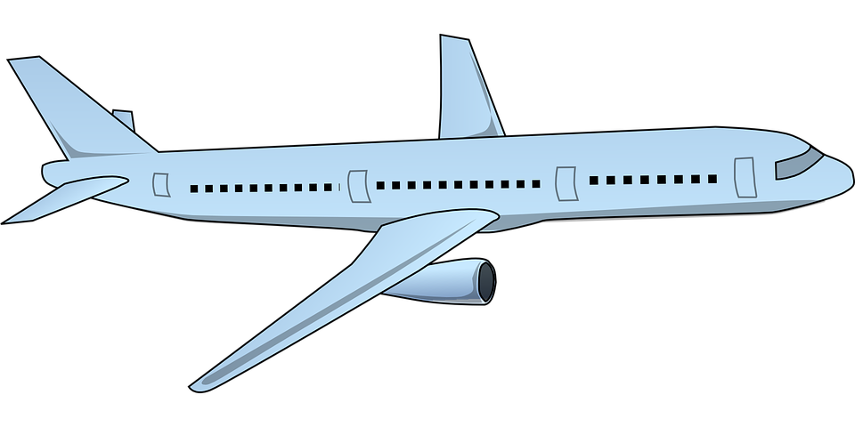

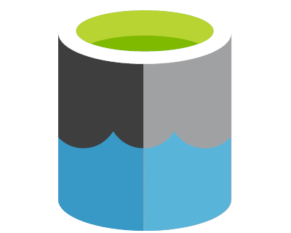





DEMO
Engine Sensor Data
(Simulated)
IoT Hub
Stream Analytics
Power BI
Azure Data Lake
Gen2

Slide 13
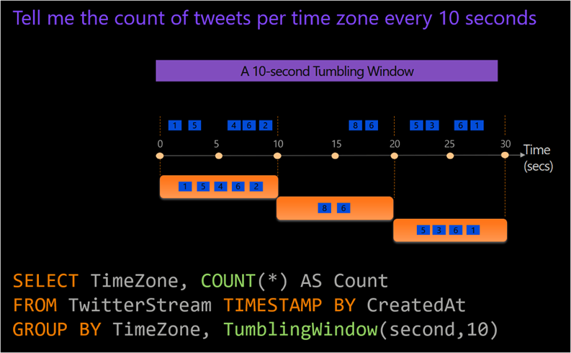
Tumbling Window (Fixed)

Slide 14
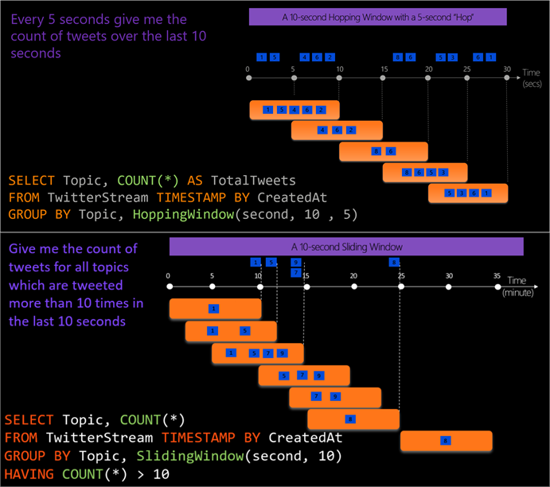
Hopping Window
Note: tumbling window is a hopping window whose ‘hop’ is equal to its ‘size’
Sliding Window
when an event entered or exits the window

Slide 15
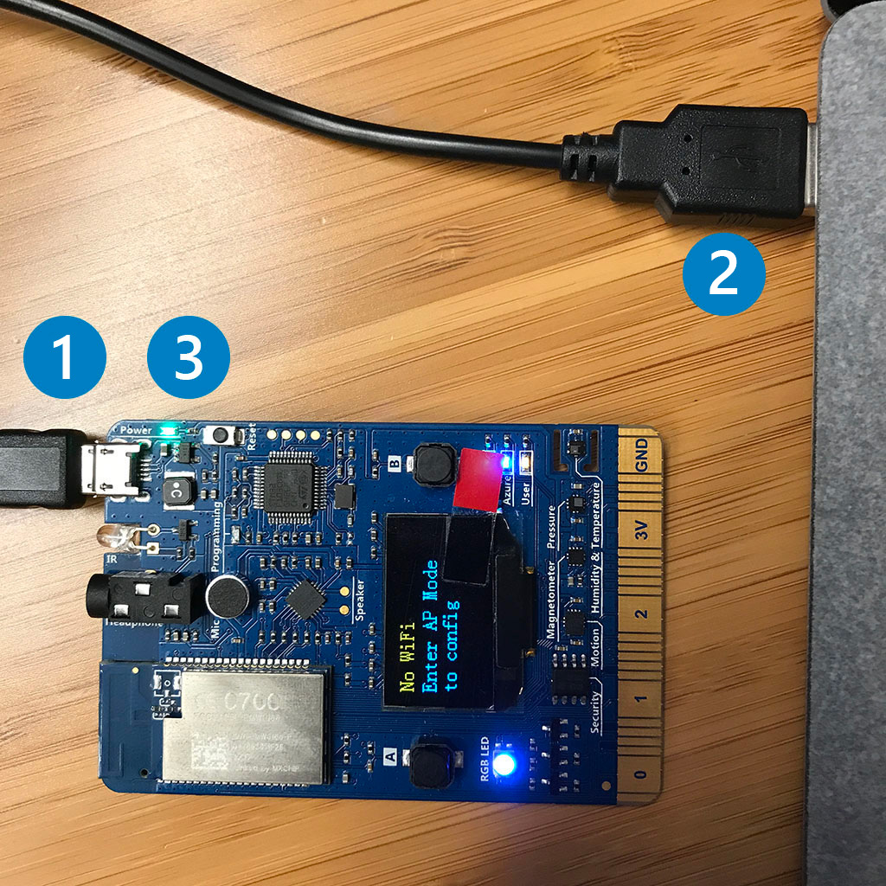
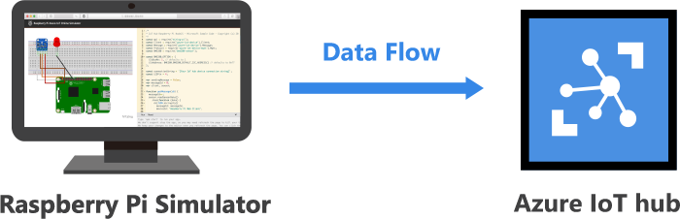
Azure MXChip IoT DevKit
A MXChip IoT DevKit board with a Micro-USB cable - $39
The Raspberry Pi is a low cost, credit-card sized computer that plugs into a computer monitor or TV, and uses a standard keyboard and mouse.
Connect Raspberry Pi online simulator to Azure IoT Hub
Notes:
Assembly area - The default circuit is that a Pi connects with a BME280 sensor and an LED. The area is locked in preview version so currently you cannot do customization.
Coding area - An online code editor for you to code with Raspberry Pi. The default sample application helps to collect sensor data from BME280 sensor and sends to your Azure IoT Hub. The application is fully compatible with real Pi devices.
Integrated console window - It shows the output of your code. At the top of this window, there are three buttons.
Run - Run the application in the coding area.
Reset - Reset the coding area to the default sample application.
Fold/Expand - On the right side there is a button for you to fold/expand the console window.

